Slide 1

April 27, 2026
Advanced Molecular Detection Southeast Region

Slide 2
This resource was made possible through funding provided under the Epidemiology and Laboratory Capacity for Prevention and Control of Emerging Infectious Diseases (ELC) Cooperative Agreement (CK24-0002), Project D: Advanced Molecular Detection to the Florida Department of Health. The conclusions, findings, and opinions expressed by authors do not necessarily reflect the official position of the U.S. Department of Health and Human Services, the Public Health Service, or the Centers for Disease Control and Prevention.

Slide 3
UPDATES
In‑Person Training (July 16–17, Athens, GA):
Two‑day, on‑site workshop focused on hands‑on genomic epidemiology tools, guided exercises, and real‑world applications.
Supports preparation for the 12‑week series through interactive sessions, pipeline walkthroughs, and small‑group work.
Please begin working on internal travel approvals for 2 people, ideally one epidemiologist and one lead laboratorian
15-week training online – expansion on Genomic Epi
HiPerGator
Changes to how we request new accounts
Still figuring out the system and will update our directions as needed
IF you have any issues with accessing HPG, let Molly Mitchell know ASAP

Slide 4

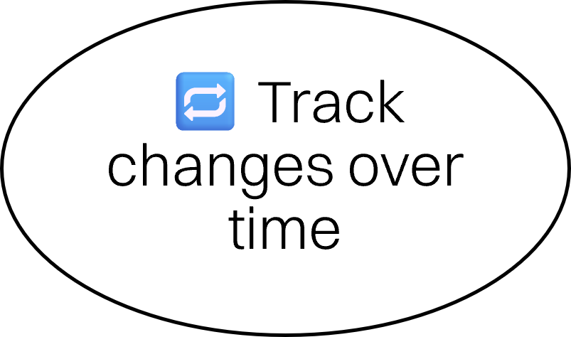
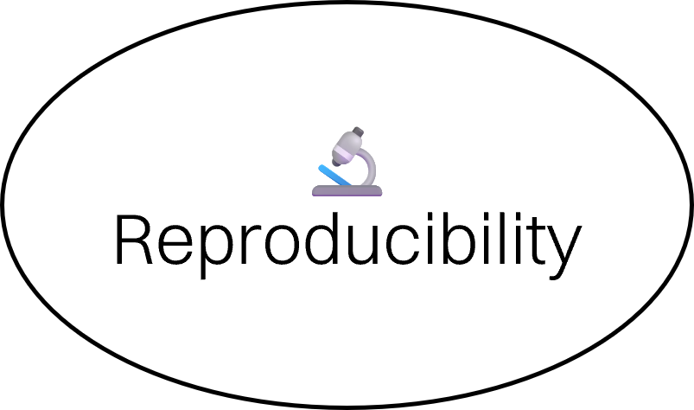
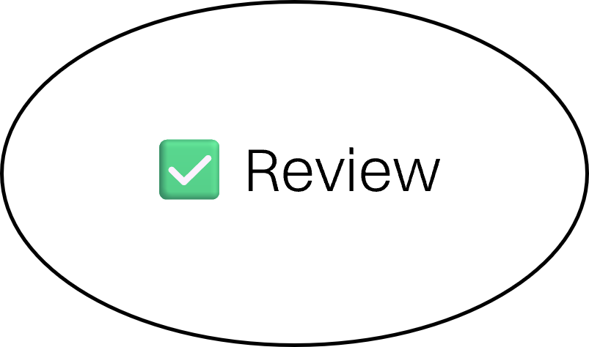
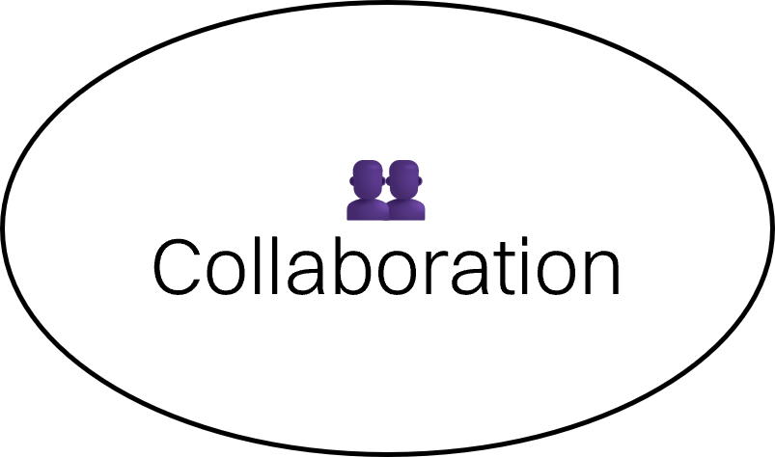
Why GitHub?
🔁 Track changes over time
👥 Collaboration
✅ Review
🔬 Reproducibility

Slide 5
GitHub Vs. HPG
GitHub → Code Management
HPG → Pipeline Execution
Together → Complete Workflow

Slide 6
Core Concepts
Repository = Project
Commit = Save
Branch = Separate Work
Pull Request = Review

Slide 7
Workflow
Main (stable)
Clone/Fork
Feature Branch
Develop (working)
Commit + Push

Slide 8
Review Process
Create a pull request
Assign reviewers
Address feedback
Merge after approval

Slide 9
Repository Structure
Core Files
README.md
LICENSE
CHANGELOG.md
Nextflow.config
params.yaml
main.nf
Common Folders
modules/
subworkflows/
bin/
assets/
test/
Environment
environment.yaml
Side Note:
Example for Nextflow Pipelines

Slide 10
License
Defines how code can be used and shared
Required repository file
MIT → default
Other Options:
Apache 2.0
GPL v3
CC BY 4.0
Custom / Institutional

Slide 11
Versioning
Version Numbering Schema
X.Y.Z
X → Major Change
Y → Minor Change
Z → Patch Change
Side Note:
Tag stable releases on main

Slide 12
Best Practices
Do not work directly on main!
Do not include sensitive data
Use pull requests
Write clear commit messages
Keep documentation updated

Slide 13
Live Demo
Create/Clone Repository Locally
Create Develop Branch
Add/Change Key Files
Commit + Push → GitHub (Main Exist)
Open Pull Request
Review & Merge

Slide 14
Git Commands
## One-time setup
git config --global user.name "Your Name“
git config --global user.email@email.com
## SSH keys
GitHub removed password authentication for git in August 2021. Use SSH keys (recommended) or a Personal Access Token. We can provide guidance on this.
## Creating & Cloning
git init # start a new local repo
git clone <url> # copy an existing repo to your machine
## Pulling
git pull # fetch latest changes/updates from remote
git fetch # fetch without merging (check what changes/updates are out there)
## Branching
git branch # list local branches
git checkout -b <branch-name> # create and switch to a new branch (use this one)
git checkout <branch-name> # switch to an existing branch
Never work directly on `main`. Always branch first.

Slide 15
Git Commands Cont.
## Staging & Committing
git status # see what changed
git diff # see line-by-line changes before staging
git add <file> # stage a specific file
git add . # stage everything
git commit -m "your message" # commit with a short, descriptive message
## Pushing
git push -u origin <branch-name> # first push of a new branch (sets upstream)
git push # subsequent pushes
## Useful Extras
git log --oneline # condensed commit history
git restore <file> # discard local changes to a file

Slide 16
Resources
GitHub SOP - External (Available upon request)
GitHub Pipeline Review Job Aid - External (Available upon request)
GitHub Documentation
Nextflow Documentation
HPG to VS Code OH
https://github.com/StaPH-B/southeast-region/blob/master/trainings/office%20hours/20250714_Session51_VScode%20Training%20Pt%201.pdf
Contact Us
Request SOP:
bphl-sebioinformatics@flhealth.gov

Slide 17

Questions?
bphl-sebioinformatics@flhealth.gov
Molly Mitchell, PhD
Bioinformatics Supervisor
Molly.Mitchell@flhealth.gov
Nikhil Reddy, MS
Bioinformatician
Nikhil.Yengala@flhealth.gov
Sam Bernhoft, MPH
Bioinformatician
Samantha.bernhoft@flhealth.gov

Slide 18
🔁 Track Changes Over Time
Full Version History
See what changed & when

Slide 19
👥 Collaboration
Multiple users work together
No overwriting code

Slide 20
✅ Review
Changes reviewed before merge
Pull requests for approval

Slide 21
🔬 Reproducibility
Versioned pipelines
Same results every time

Slide 22
🔁 Track changes over time
Why Github?
🔬 Reproducibility
👥 Collaboration
✅ Review

